Slide 1
Procedures in PL/SQL
Rushali Patil

Slide 2
Procedure
Procedures are subprograms that do not return a value directly
It is used to perform an action
It consists of following part:
Declarative
Executable
Exception-handling

Slide 3
Procedure Syntax in MYSQL
CREATE PROCEDURE sp_name ([proc_parameter[,...]]) routine_body
proc_parameter: [ IN | OUT | INOUT ] param_name type

Slide 4
Functions in PL/SQL
The PL/SQL Function is very similar to PL/SQL Procedure.
The main difference between procedure and a function is,
a function must always return a value, and
a procedure may or may not return a value.

Slide 5
Function Syntax in MYSQL
CREATE FUNCTION function_name RETURNS {STRING|INTEGER|REAL|DECIMAL}

Slide 6
Procedure and Function Syntax in MYSQL
These statements are used to create a stored routine (a stored procedure or function).
That is, the specified routine becomes known to the server.
By default, a stored routine is associated with the default database.
To associate the routine explicitly with a given database, specify the name as db_name.sp_name when you create it.
To invoke a stored procedure, use the CALL statement
To invoke a stored function, refer to it in an expression (SELECT). The function returns a value during expression evaluation.

Slide 7
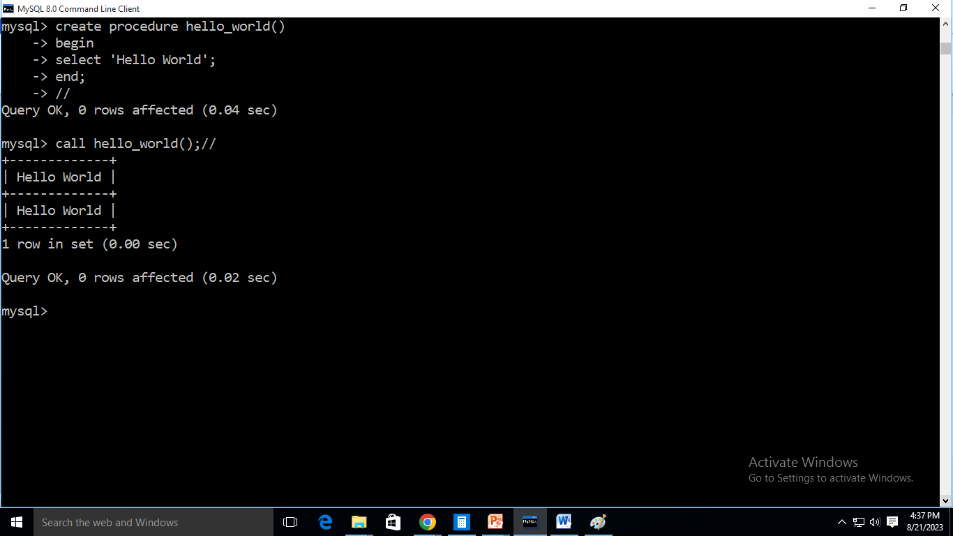
Procedure Example

Slide 8
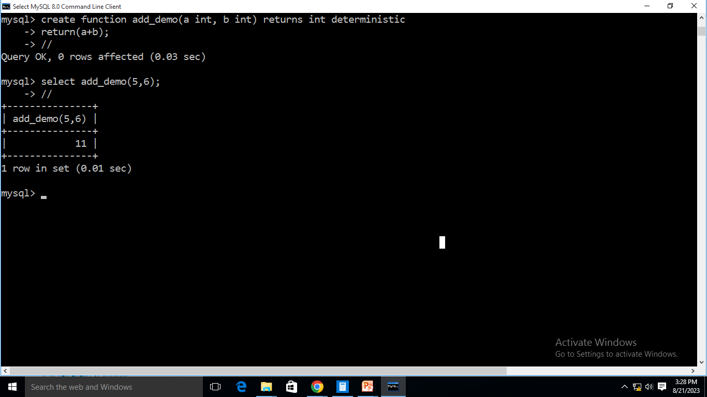
Function Example

Slide 9
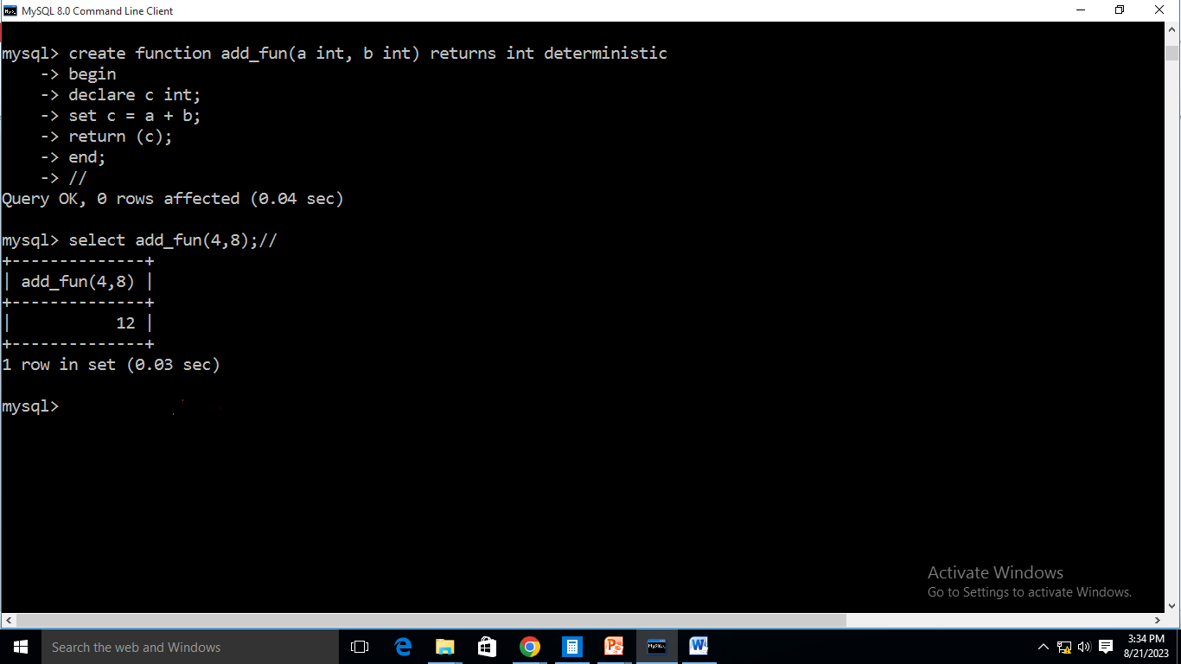
Function Example

Slide 10
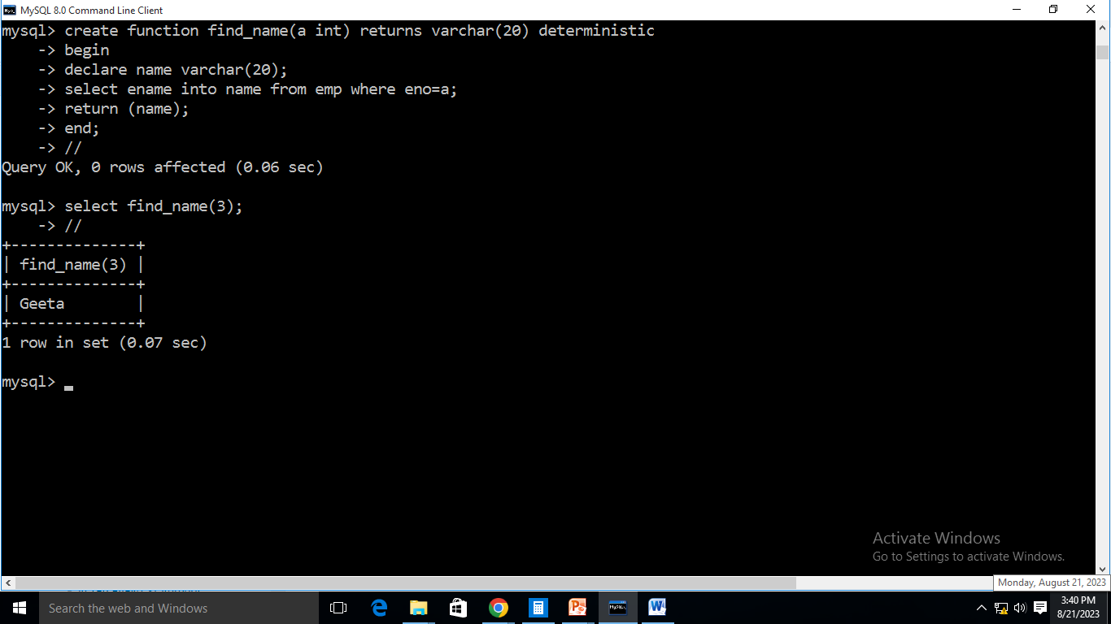
Function Example

Slide 11
Parameter Modes in Procedure
IN parameters:
The IN parameter can be referenced by the procedure or function.
The value of the parameter cannot be overwritten by the procedure or the function.
OUT parameters:
The OUT parameter cannot be referenced by the procedure or function,
But value of the parameter can be overwritten by the procedure or function.
INOUT parameters:
The INOUT parameter can be referenced by the procedure or function and
the value of the parameter can be overwritten by the procedure or function.

Slide 12
Parameter Modes in Procedure
The parameter
list enclosed within parentheses must always be present
if there are no parameters, an empty parameter list of () should be used
parameter names are not case-sensitive
Each parameter is an IN parameter by default. To specify otherwise for a parameter, use the keyword OUT or INOUT before the parameter name.
NOTE: Specifying a parameter as IN, OUT, or INOUT is valid only for a PROCEDURE. For a FUNCTION, parameters are always regarded as IN parameters.

Slide 13
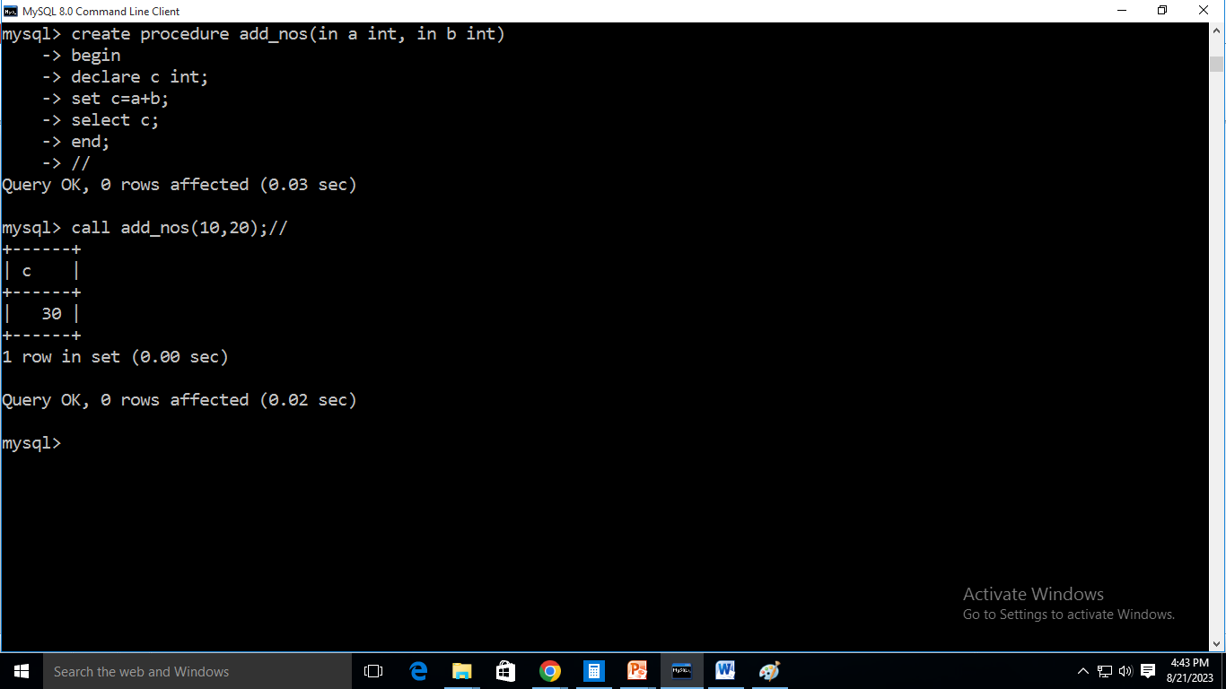
Parameter Passing Example

Slide 14
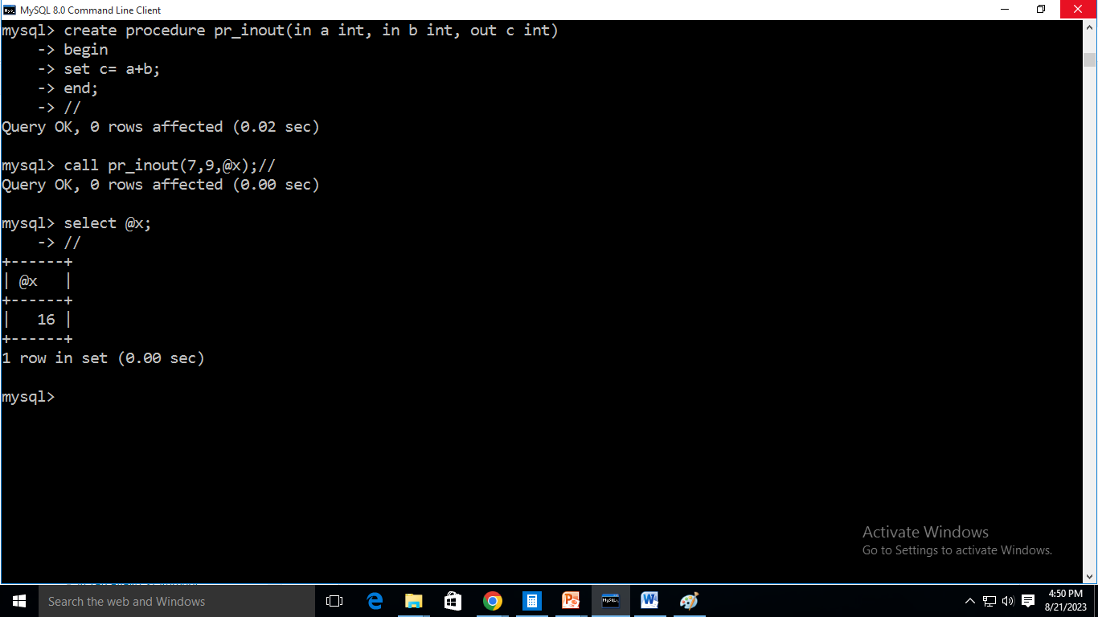
Parameter Passing Example

Slide 15
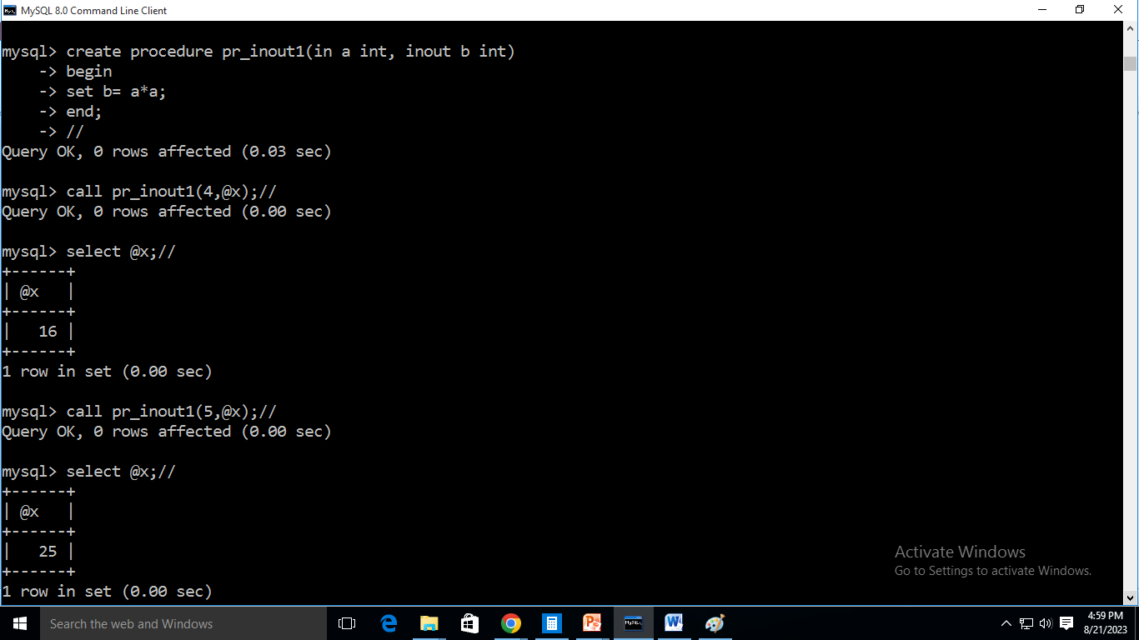
Parameter Passing Example

